Slide 1
Mummy’s get together club
1:30-3:30 PM Tuesday: Exercise class (Safety Bay foreshore)
1:30-3:30 PM Thursday: Cooking class (Address given privately)

Slide 2
Mummy’s get together Information
Mums are invited to join up to either our two hour exercise program or two hour cooking class or both.
Both programs are a great way to get back into shape and get yourself out of the house and communicating with other parents like yourselves.
Best of all its free. ☺

Slide 3
Contact me to join
To join up to this exciting group please contact me (Rebecca Bowley) by email it is Bekbowley@msn.com.

Slide 4
Taste
Once you have joined mummy's club you will be invited to join taste which is a website designed to let you look up recipes, share your own, chat the people on forums or in your club. Each week we will chat about what people would like to cook for our next visit together.

Slide 5
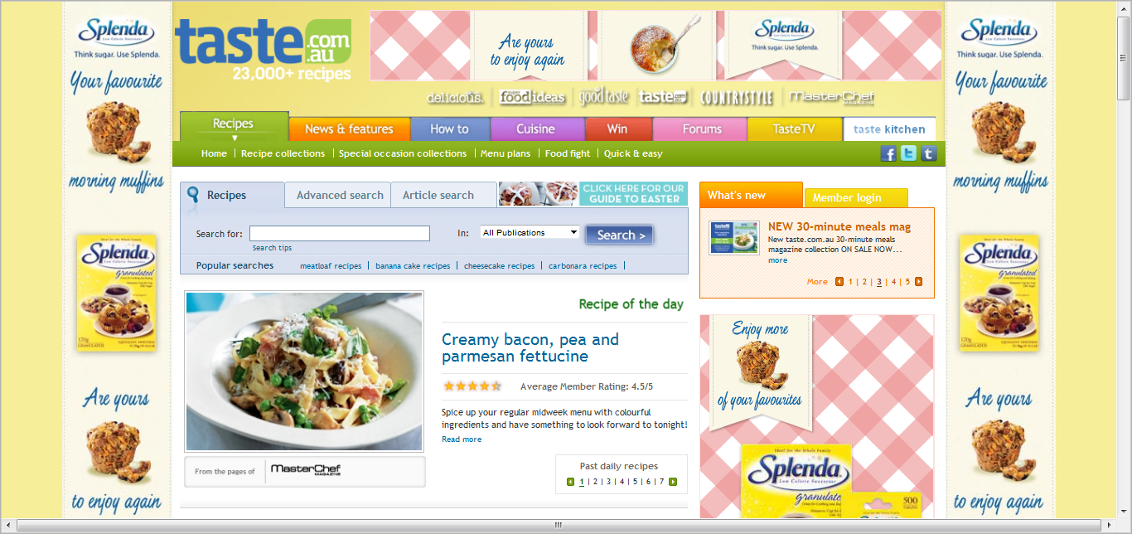
How to sign up to taste?
First of all you need to open your web browser and put in www.taste.com.au you will then be taken to the home page which looks like this…

Slide 6
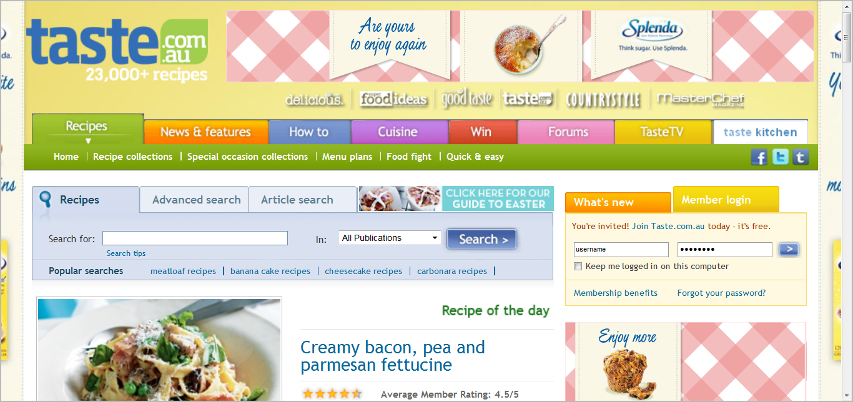
From this page you have to click on member login and click on the link that says You're invited! Join Taste.com.au today - it's free just below it.

Slide 7
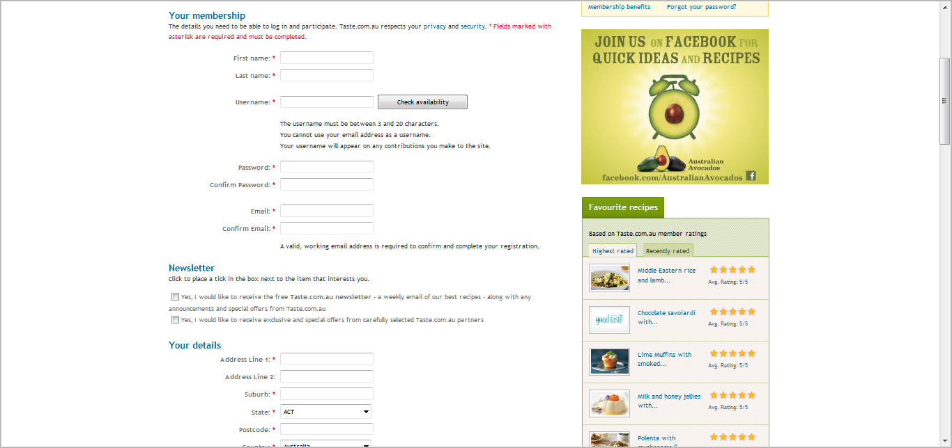
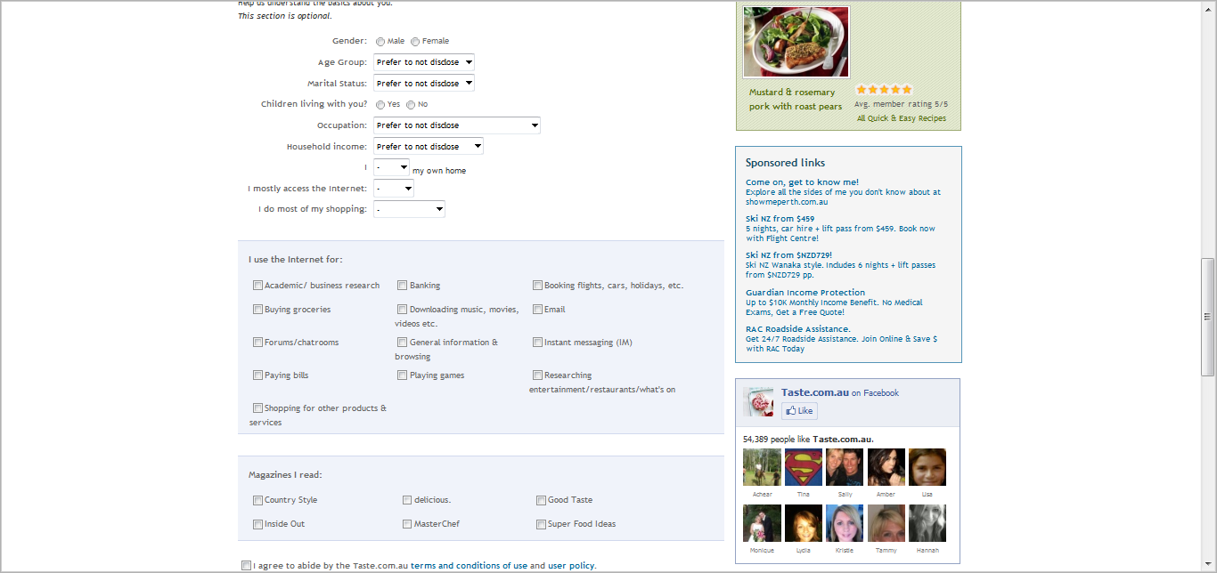
You will then be
brought to this page
which you must fill out.

Slide 8
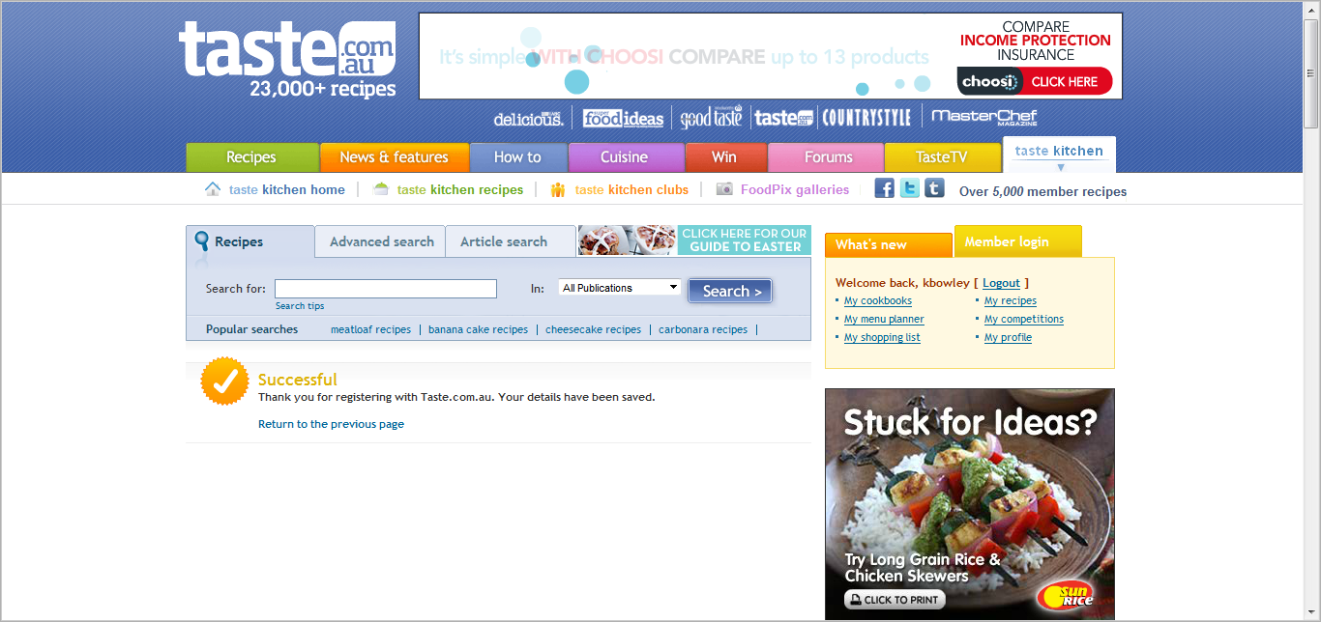
Taste will then congratulate you for joining their website from here you can start the explore all the great things this webpage offers.

Slide 9
When you have finished browsing you can then go and sign up from our club on taste this is where we can chat about
Our favourite recipes and how you found or created them.
Give tips and share hints on cooking.
Share stories about the food experiences you have had with your kids.
Discuss what everyone would like to learn to cook In our next work shops coming up.
Share different cook books that you think others would like.
And just anything that relates to our club and the people involved.
Check out the next slide to find out how to find or club on taste.

Slide 10
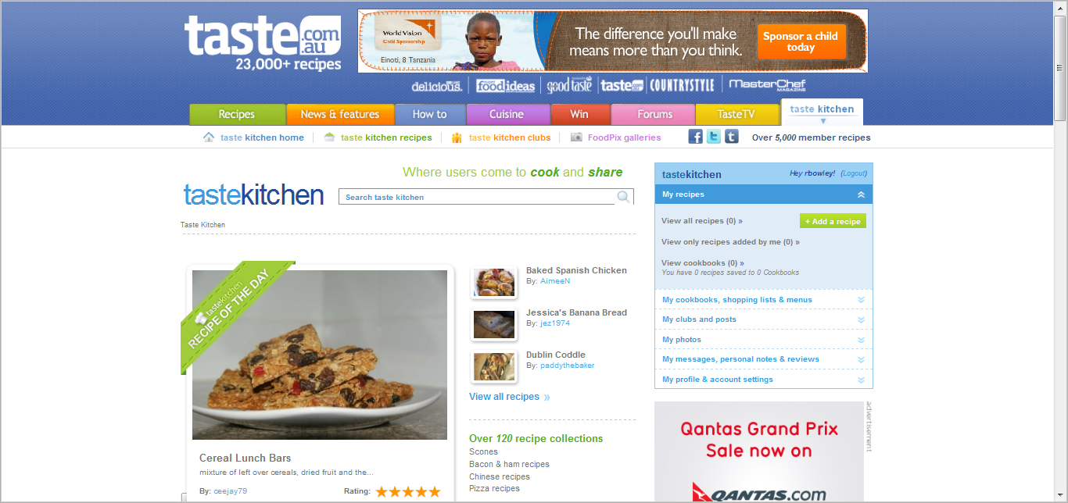
So to join our chat group you can either follow this link http://www.taste.com.au/kitchen/clubs/fitness+for+mums,41 which I think is the most simple way, or you can click on the taste kitchen clubs link and look up ‘fitness for mums’

Slide 11
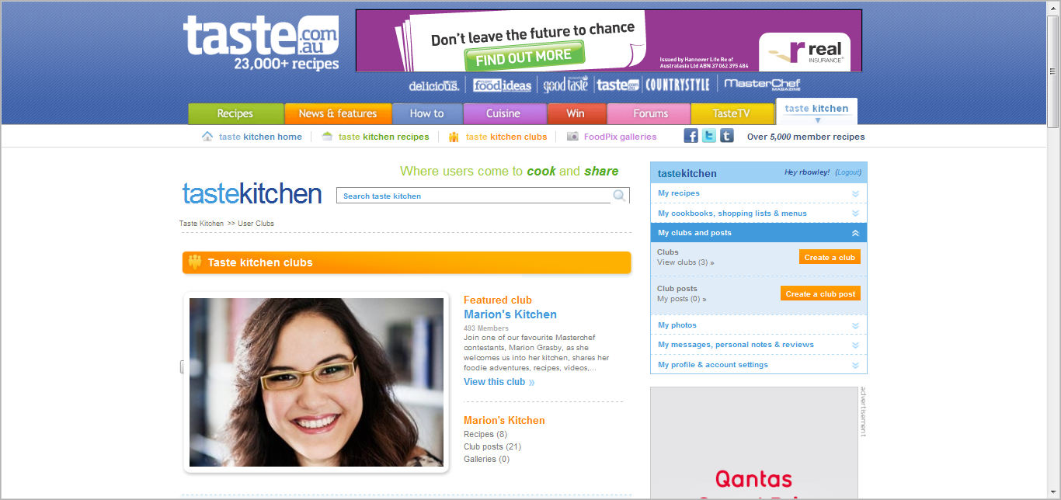
Once you are here you can now press on the create club post button to share you thoughts.
Enjoy!

